Slide 1
CH – 2 Data Collection and Preprocessing
-RitIka Jani.
IT, DEPSTAR

Slide 2
Contents
Data Collection Strategies
Labeling, and Validating data
Data Pre-Processing Overview
Feature Engineering
Transformation and Selection
Data Augmentation
Preprocessing Different Data Types

Slide 3
Data Collection Strategies
What is Data Collection?
Data collection is the process of collecting, measuring and analyzing different types of information using a set of standard validated techniques.

Slide 4
Why do we need to collect data?
Collecting data allows you to store and analyze important information from data for future insights.
Data Empowers You To Make Informed Decisions.
Data Helps You Identify Problems
Data Will Back Up Your Arguments
Data Allows You To Develop Accurate Theories
Data Tells You What You’re Doing Well
Data Saves You Time
Data Increases Your Return On Assets
Data Improves Quality Of Life

Slide 5
Sources of Data Collections?
Sources of the data is classified into two categories – Statistical and non-statistical.
Statistical sources refer to data that is gathered for some official purpose, incorporate censuses, and officially administered surveys. Non-statistical sources refer to the collection of data for other administrative purposes or for the private sector.

Slide 6
What are common challenges in data collection?
Data quality issues: Raw data typically includes errors, inconsistencies and other issues. Ideally, data collection measures are designed to avoid or minimize such problems. As a result, collected data usually needs to be put through data profiling to identify issues and data cleansing to fix them.
Finding relevant data. With a wide range of systems to navigate, gathering data to analyze can be a complicated task for data scientists and other users in an organization. The use of data curation techniques helps make it easier to find and access data. For example, that might include creating a data catalog and searchable indexes.
Deciding what data to collect. This is a fundamental issue both for upfront collection of raw data and when users gather data for analytics applications. Collecting data that isn't needed adds time, cost and complexity to the process. But leaving out useful data can limit a data set's business value and affect analytics results.
Dealing with big data. Big data environments typically include a combination of structured, unstructured and semi structured data, in large volumes. That makes the initial data collection and processing stages more complex. In addition, data scientists often need to filter sets of raw data stored in a data lake for specific analytics applications.
Low response and other research issues. In research studies, a lack of responses or willing participants raises questions about the validity of the data that's collected. Other research challenges include training people to collect the data and creating sufficient quality assurance procedures to ensure that the data is accurate.

Slide 7
Data Collection Strategies (Contd..)
Based on nature there are two types of data collection.
Primary Data Source
Secondary Data Source

Slide 8
Primary Data Collection Strategies (Contd..)
Primary Data Collection Methods: Primary data refers to data collected from first-hand experience directly from the main source.
It refers to data that has never been used in the past. The data gathered by primary data collection methods are generally regarded as the best kind of data in research.
The methods of collecting primary data can be further divided into quantitative data collection methods and qualitative data collection methods.

Slide 9
Primary Data Collection Strategies (Contd..)
Interviews: Interviews are a direct method of data collection. It is simply a process in which the interviewer asks questions and the interviewee responds to them.
It provides a high degree of flexibility because questions can be adjusted and changed anytime according to the situation.
Surveys and Questionnaires: Surveys and questionnaires provide a broad perspective from large groups of people. They can be conducted face-to-face, mailed, or even posted on the Internet to get respondents from anywhere in the world.
The answers can be yes or no, true or false, multiple choice, and even open-ended questions. However, a drawback of surveys and questionnaires is delayed response and the possibility of ambiguous answers.
Focus Groups: A focus group is similar to an interview, but it is conducted with a group of people who all have something in common. The data collected is similar to in-person interviews, but they offer a better understanding of why a certain group of people thinks in a particular way.
However, some drawbacks of this method are lack of privacy and domination of the interview by one or two participants.
Focus groups can also be time-consuming and challenging, but they help reveal some of the best information for complex situations.

Slide 10
Primary Data Collection Strategies (Contd..)
Oral Histories: Oral histories also involve asking questions like interviews and focus groups. However, it is defined more precisely and the data collected is linked to a single phenomenon.
It involves collecting the opinions and personal experiences of people in a particular event that they were involved in.
For example, it can help in studying the effect of a new product in a particular community.
Observations: In this method, researchers observe a situation around them and record the findings. It can be used to evaluate the behavior of different people in controlled and uncontrolled situations.
This method is highly effective because it is straightforward and not directly dependent on other participants.
Experimental method: The experimental method is the process of collecting data through performing experiments, research, and investigation. The most frequently used experiment methods are CRD, RBD, LSD, FD.
CRD- Completely Randomized design is a simple experimental design used in data analytics which is based on randomization and replication. It is mostly used for comparing the experiments.
RBD- Randomized Block Design is an experimental design in which the experiment is divided into small units called blocks. Random experiments are performed on each of the blocks and results are drawn using a technique known as analysis of variance (ANOVA). RBD was originated from the agriculture sector.
LSD – Latin Square Design is an experimental design that is similar to CRD and RBD blocks but contains rows and columns. It is an arrangement of NxN squares with an equal amount of rows and columns which contain letters that occurs only once in a row. Hence the differences can be easily found with fewer errors in the experiment. Sudoku puzzle is an example of a Latin square design.
FD- Factorial design is an experimental design where each experiment has two factors each with possible values and on performing trail other combinational factors are derived.

Slide 11
Secondary Data Collection Strategies (Contd..)
Secondary data refers to data that has already been collected by someone else. It is much more inexpensive and easier to collect than primary data.
While primary data collection provides more authentic and original data, there are numerous instances where secondary data collection provides great value to organizations.

Slide 12
Secondary Data Collection Strategies (Contd..)
Internet: The use of the Internet has become one of the most popular secondary data collection methods in recent times. There is a large pool of free and paid research resources that can be easily accessed on the Internet.
While this method is a fast and easy way of data collection, you should only source from authentic sites while collecting information.
Government Archives: There is lots of data available from government archives that you can make use of. The most important advantage is that the data in government archives are authentic and verifiable.
For example, criminal records can come under classified information and are difficult for anyone to have access to them.
Libraries: Most researchers donate several copies of their academic research to libraries. You can collect important and authentic information based on different research contexts.
Libraries also serve as a storehouse for business directories, annual reports and other similar documents that help businesses in their research.

Slide 13
Data Labeling
Data labeling is the process of identifying raw data (images, text files, videos, etc.) and adding one or more meaningful and informative labels to provide context so that a model can learn from it.
For example, labels might indicate whether a photo contains a bird or car, which words were uttered in an audio recording, or if an x-ray contains a tumor.
Data labeling is required for a variety of use cases including computer vision, natural language processing, and speech recognition.

Slide 14
Case study
Imagine you want to start an agribusiness and your goal is to maximize profits by growing abundant, good-quality crops.

Slide 15
How Data Labeling Works
Companies integrate software, processes and data annotators to clean, structure and label data.
This training data becomes the foundation for machine learning models.
These labels allow analysts to isolate variables within datasets, and this enables the selection of optimal data predictors for ML models.
The labels identify the appropriate data vectors to be pulled in for model training, and then the model learns to make the best predictions.

Slide 16
Why to pre-process data?
Section - 1

Slide 17
Why to pre-process data?
Data pre-processing is a data mining technique that involves transforming raw data (real world data) into an understandable format.
Real-world data is often incomplete, inconsistent, lacking in certain behaviors or trends and likely to contain many errors.
Incomplete: Missing attribute values, lack of certain attributes of interest, or containing only aggregate data.
E.g. Occupation = “ ”
Noisy: Containing errors or outliers.
E.g. Salary = “abcxy”
Inconsistent: Containing similarity in codes or names.
E.g. “Gujarat” & “Gujrat” (Common mistakes like spelling, grammar, articles)

Slide 18



Why to pre-process data? (Cont..)
No quality data, No quality results
It looks like Garbage In Garbage Out (GIGO).
Quality decisions must be based on quality data.
Duplicate or missing data may cause incorrect or even misleading statistics.
Data preprocessing prepares raw data for further processing.
Data preparation, cleaning and transformation are the majority task (90%) in data mining.

Slide 19
Data Quality: Why Preprocess the Data?
Measures for data quality: A multidimensional view
Accuracy: correct or wrong, accurate or not
Completeness: not recorded, unavailable, …
Consistency: some modified but some not, dangling, …
Timeliness: timely update?
Believability: how trustable the data are correct?
Interpretability: how easily the data can be understood?

Slide 20
Major Tasks in Data Preprocessing
Data cleaning
Fill in missing values, smooth noisy data, identify or remove outliers, and resolve inconsistencies
Data integration
Integration of multiple databases, data cubes, or files
Data reduction
Dimensionality reduction
Numerosity reduction
Data compression
Data transformation and data discretization
Normalization
Concept hierarchy generation

Slide 21
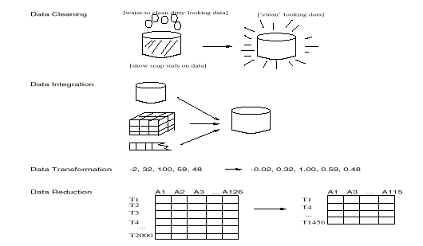
Forms of data preprocessing

Slide 22
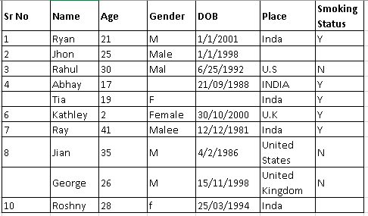

Slide 23
Data Cleaning
Data in the Real World Is Dirty: Lots of potentially incorrect data, e.g., instrument faulty, human or computer error, transmission error
incomplete: lacking attribute values, lacking certain attributes of interest, or containing only aggregate data
e.g., Occupation=“ ” (missing data)
noisy: containing noise, errors, or outliers
e.g., Salary=“−10” (an error)
inconsistent: containing discrepancies in codes or names, e.g.,
Age=“42”, Birthday=“03/07/2010”
Was rating “1, 2, 3”, now rating “A, B, C”
discrepancy between duplicate records
Intentional (e.g., disguised missing data)
Jan. 1 as everyone’s birthday?

Slide 24
Incomplete (Missing) Data
Data is not always available
E.g., many tuples have no recorded value for several attributes, such as customer income in sales data
Missing data may be due to
equipment malfunction
inconsistent with other recorded data and thus deleted
data not entered due to misunderstanding
certain data may not be considered important at the time of entry
not register history or changes of the data
Missing data may need to be inferred

Slide 25
How to Handle Missing Data?
Ignore the tuple: usually done when class label is missing (when doing classification)—not effective when the % of missing values per attribute varies considerably
Fill in the missing value manually: tedious + infeasible?
Fill in it automatically with
a global constant : e.g., “unknown”, a new class?!
the attribute mean
the attribute mean for all samples belonging to the same class: smarter
the most probable value: inference-based such as Bayesian formula or decision tree

Slide 26
Noisy Data
What is noise?
It is a random error or variance in a measured variable
Incorrect attribute values may be due to
faulty data collection instruments
data entry problems
data transmission problems
technology limitation
inconsistency in naming convention
Other data problems which require data cleaning
duplicate records
incomplete data
inconsistent data
26
Notes:
26

Slide 27
How to Handle Noisy Data?
Binning
first sort data and partition into (equal-frequency) bins
then one can smooth by bin means, smooth by bin median, smooth by bin boundaries, etc.
Regression
smooth by fitting the data into regression functions
Clustering
detect and remove outliers
Combined computer and human inspection
detect suspicious values and check by human (e.g., deal with possible outliers)

Slide 28
Simple Discretization Methods: Binning
Equal-width (distance) partitioning:
It divides the range into N intervals of equal size: uniform grid
if A and B are the lowest and highest values of the attribute, the width of intervals will be: W = (B-A)/N.
The most straightforward
But outliers may dominate presentation
Skewed data is not handled well.
Equal-depth (frequency) partitioning:
It divides the range into N intervals, each containing approximately same number of samples
Good data scaling
Managing categorical attributes can be tricky.

Slide 29
Binning Methods for Data Smoothing
* Sorted data for price (in dollars): 4, 8, 9, 15, 21, 21, 24, 25, 26, 28, 29, 34
* Partition into (equi-depth) bins:
- Bin 1: 4, 8, 9, 15
- Bin 2: 21, 21, 24, 25
- Bin 3: 26, 28, 29, 34
* Smoothing by bin means:
- Bin 1: 9, 9, 9, 9
- Bin 2: 23, 23, 23, 23
- Bin 3: 29, 29, 29, 29
* Smoothing by bin boundaries:
- Bin 1: 4, 4, 4, 15
- Bin 2: 21, 21, 25, 25
- Bin 3: 26, 26, 26, 34

Slide 30
Cluster Analysis

Slide 31
Regression
y
Y1
Y1’
y = x + 1
X1
x
Linear regression (best line to fit
two variables)
Multiple linear regression (more
than two variables, fit to a
multidimensional surface

Slide 32
How to Handle Inconsistent Data?
Manual correction using external references
Semi-automatic using various tools
To detect violation of known functional dependencies and data constraints
To correct redundant data

Slide 33
Data Cleaning as a Process
Data discrepancy detection
Use metadata (e.g., domain, range, dependency, distribution)
Check field overloading
Check uniqueness rule, consecutive rule and null rule
Use commercial tools
Data scrubbing: use simple domain knowledge (e.g., postal code, spell-check) to detect errors and make corrections
Data auditing: by analyzing data to discover rules and relationship to detect violators (e.g., correlation and clustering to find outliers)
Data migration and integration
Data migration tools: allow transformations to be specified
ETL (Extraction/Transformation/Loading) tools: allow users to specify transformations through a graphical user interface
Integration of the two processes
Iterative and interactive (e.g., Potter’s Wheels)

Slide 34
Data Integration
Data integration:
Combines data from multiple sources into a coherent store
Schema integration: e.g., A.cust-id ≡ B.cust-#
Integrate metadata from different sources
Entity identification problem:
Identify real world entities from multiple data sources, e.g., Bill Clinton = William Clinton
Detecting and resolving data value conflicts
For the same real world entity, attribute values from different sources are different
Possible reasons: different representations, different scales, e.g., metric vs. British units
34

Slide 35
Handling Redundancy in Data Integration
Redundant data occur often when integration of multiple databases
Object identification: The same attribute or object may have different names in different databases
Derivable data: One attribute may be a “derived” attribute in another table, e.g., annual revenue
Redundant attributes may be able to be detected by correlation analysis and covariance analysis
Careful integration of the data from multiple sources may help reduce/avoid redundancies and inconsistencies and improve mining speed and quality
35

Slide 36
Handling Redundancy in Data Integration
Redundant data occur often when integrating multiple DBs
The same attribute may have different names in different databases
One attribute may be a “derived” attribute in another table, e.g., annual revenue
Redundant data may be able to be detected by correlational analysis

Slide 37
Correlation Analysis (Nominal Data)
Χ² (chi-square) test
The larger the Χ² value, the more likely the variables are related
The cells that contribute the most to the Χ² value are those whose actual count is very different from the expected count
Correlation does not imply causality
# of hospitals and # of car-theft in a city are correlated
Both are causally linked to the third variable: population

Slide 38
Chi-Square Calculation: An Example
Χ² (chi-square) calculation (numbers in parenthesis are expected counts calculated based on the data distribution in the two categories)
It shows that like_science_fiction and play_chess are correlated in the group
 | Play chess | Not play chess | Sum (row)
Like science fiction | 250(90) | 200(360) | 450
Not like science fiction | 50(210) | 1000(840) | 1050
Sum(col.) | 300 | 1200 | 1500

Slide 39
Correlation Analysis (Numeric Data)
Correlation coefficient (also called Pearson’s product moment coefficient)
where n is the number of tuples, and are the respective means of A and B, σ_{A} and σ_{B} are the respective standard deviation of A and B, and Σ(a_{i}b_{i}) is the sum of the AB cross-product.
If r_{A,B} > 0, A and B are positively correlated (A’s values increase as B’s). The higher, the stronger correlation.
r_{A,B} = 0: independent; r_{AB} < 0: negatively correlated

Slide 40
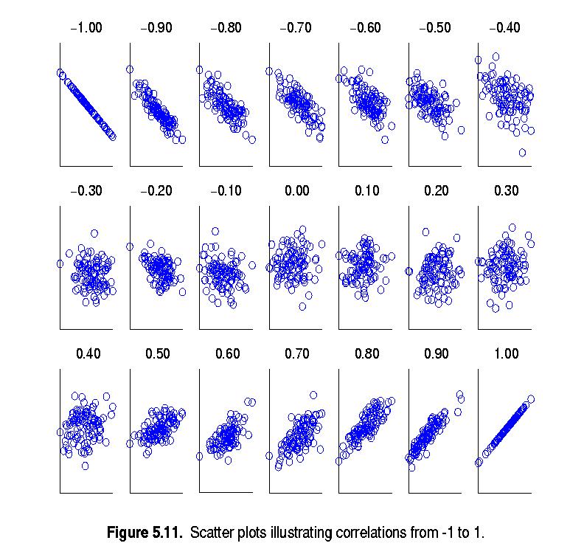
Visually Evaluating Correlation
Scatter plots showing the similarity from –1 to 1.

Slide 41
Correlation (viewed as linear relationship)
Correlation measures the linear relationship between objects
To compute correlation, we standardize data objects, A and B, and then take their dot product

Slide 42
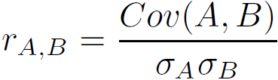
Covariance (Numeric Data)
Covariance is similar to correlation
where n is the number of tuples, and are the respective mean or expected values of A and B, σ_{A} and σ_{B} are the respective standard deviation of A and B.
Positive covariance: If Cov_{A,B} > 0, then A and B both tend to be larger than their expected values.
Negative covariance: If Cov_{A,B} < 0 then if A is larger than its expected value, B is likely to be smaller than its expected value.
Independence: Cov_{A,B} = 0 but the converse is not true:
Some pairs of random variables may have a covariance of 0 but are not independent. Only under some additional assumptions (e.g., the data follow multivariate normal distributions) does a covariance of 0 imply independence
Correlation coefficient:

Slide 43

Co-Variance: An Example
It can be simplified in computation as
Suppose two stocks A and B have the following values in one week: (2, 5), (3, 8), (5, 10), (4, 11), (6, 14).
Question: If the stocks are affected by the same industry trends, will their prices rise or fall together?
E(A) = (2 + 3 + 5 + 4 + 6)/ 5 = 20/5 = 4
E(B) = (5 + 8 + 10 + 11 + 14) /5 = 48/5 = 9.6
Cov(A,B) = (2×5+3×8+5×10+4×11+6×14)/5 − 4 × 9.6 = 4
Thus, A and B rise together since Cov(A, B) > 0.

Slide 44
Data Reduction Strategies
Data reduction: Obtain a reduced representation of the data set that is much smaller in volume but yet produces the same (or almost the same) analytical results
Why data reduction? — A database/data warehouse may store terabytes of data. Complex data analysis may take a very long time to run on the complete data set.
Data reduction strategies
Dimensionality reduction, e.g., remove unimportant attributes
Wavelet transforms
Principal Components Analysis (PCA)
Feature subset selection, feature creation
Numerosity reduction (some simply call it: Data Reduction)
Regression and Log-Linear Models
Histograms, clustering, sampling
Data cube aggregation
Data compression

Slide 45
Data Reduction 1: Dimensionality Reduction
Curse of dimensionality
When dimensionality increases, data becomes increasingly sparse
Density and distance between points, which is critical to clustering, outlier analysis, becomes less meaningful
The possible combinations of subspaces will grow exponentially
Dimensionality reduction
Avoid the curse of dimensionality
Help eliminate irrelevant features and reduce noise
Reduce time and space required in data mining
Allow easier visualization
Dimensionality reduction techniques
Wavelet transforms
Principal Component Analysis
Supervised and nonlinear techniques (e.g., feature selection)
Notes:
45

Slide 46
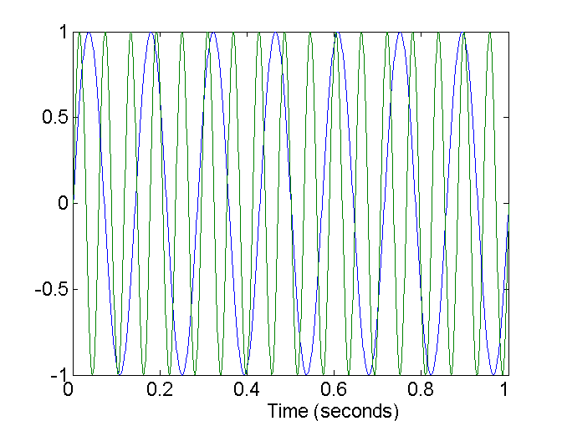
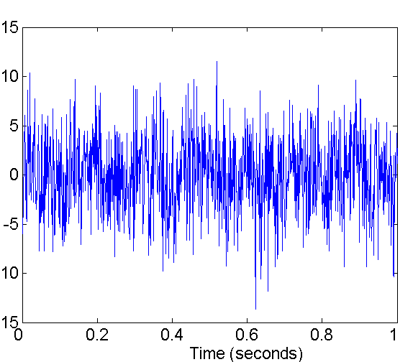
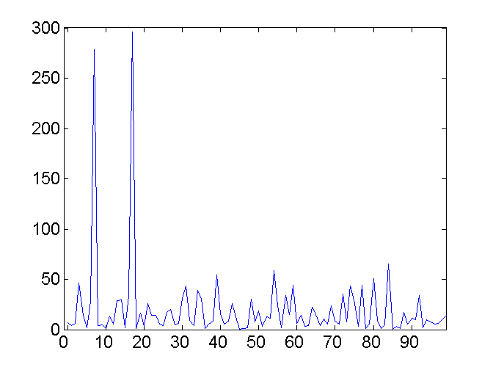
Mapping Data to a New Space
Fourier transform
Wavelet transform
Two Sine Waves
Two Sine Waves + Noise
Frequency
Notes:
46

Slide 47
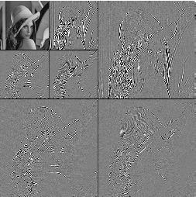
What Is Wavelet Transform?
Decomposes a signal into different frequency subbands
Applicable to n-dimensional signals
Data are transformed to preserve relative distance between objects at different levels of resolution
Allow natural clusters to become more distinguishable
Used for image compression
Notes:
47

Slide 48
Wavelet Transformation
Discrete wavelet transform (DWT) for linear signal processing, multi-resolution analysis
Compressed approximation: store only a small fraction of the strongest of the wavelet coefficients
Similar to discrete Fourier transform (DFT), but better lossy compression, localized in space
Method:
Length, L, must be an integer power of 2 (padding with 0’s, when necessary)
Each transform has 2 functions: smoothing, difference
Applies to pairs of data, resulting in two set of data of length L/2
Applies two functions recursively, until reaches the desired length
Haar2
Daubechie4
Notes:
48

Slide 49
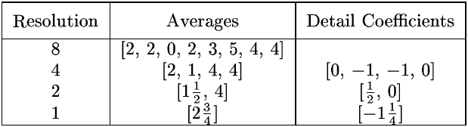
Wavelet Decomposition
Wavelets: A math tool for space-efficient hierarchical decomposition of functions
S = [2, 2, 0, 2, 3, 5, 4, 4] can be transformed to S^ = [2³/₄, -1¹/₄, ¹/₂, 0, 0, -1, -1, 0]
Compression: many small detail coefficients can be replaced by 0’s, and only the significant coefficients are retained
Notes:
49

Slide 50
Haar Wavelet Coefficients
Coefficient “Supports”
₊
Hierarchical decomposition structure (a.k.a. “error tree”)
2.75
₋
2.75
₊
+
-1.25
₋
+
-1.25
-
₊
0.5
₋
0.5
0
₊
+
-
+
-
0
₋
0
-1
-1
0
₊
0
₋
+
-
+
-
+
-
+
-
₊
₋
-1
2 2 0 2 3 5 4 4
₊
-1
₋
₊
Original frequency distribution
0
Notes:
50

Slide 51
Why Wavelet Transform?
Use hat-shape filters
Emphasize region where points cluster
Suppress weaker information in their boundaries
Effective removal of outliers
Insensitive to noise, insensitive to input order
Multi-resolution
Detect arbitrary shaped clusters at different scales
Efficient
Complexity O(N)
Only applicable to low dimensional data
Notes:
51

Slide 52
Principal Component Analysis (PCA)
Find a projection that captures the largest amount of variation in data
The original data are projected onto a much smaller space, resulting in dimensionality reduction. We find the eigenvectors of the covariance matrix, and these eigenvectors define the new space
x₂
e
x₁

Slide 53
Principal Component Analysis (Steps)
Given N data vectors from n-dimensions, find k ≤ n orthogonal vectors (principal components) that can be best used to represent data
Normalize input data: Each attribute falls within the same range
Compute k orthonormal (unit) vectors, i.e., principal components
Each input data (vector) is a linear combination of the k principal component vectors
The principal components are sorted in order of decreasing “significance” or strength
Since the components are sorted, the size of the data can be reduced by eliminating the weak components, i.e., those with low variance (i.e., using the strongest principal components, it is possible to reconstruct a good approximation of the original data)
Works for numeric data only

Slide 54
Attribute Subset Selection
Another way to reduce dimensionality of data
Redundant attributes
Duplicate much or all of the information contained in one or more other attributes
E.g., purchase price of a product and the amount of sales tax paid
Irrelevant attributes
Contain no information that is useful for the data mining task at hand
E.g., students' ID is often irrelevant to the task of predicting students' GPA

Slide 55
Heuristic Search in Attribute Selection
There are 2^{d} possible attribute combinations of d attributes
Typical heuristic attribute selection methods:
Best single attribute under the attribute independence assumption: choose by significance tests
Best step-wise feature selection:
The best single-attribute is picked first
Then next best attribute condition to the first, ...
Step-wise attribute elimination:
Repeatedly eliminate the worst attribute
Best combined attribute selection and elimination
Optimal branch and bound:
Use attribute elimination and backtracking

Slide 56
Attribute Creation (Feature Generation)
Create new attributes (features) that can capture the important information in a data set more effectively than the original ones
Three general methodologies
Attribute extraction
Domain-specific
Mapping data to new space (see: data reduction)
E.g., Fourier transformation, wavelet transformation, manifold approaches (not covered)
Attribute construction
Combining features (see: discriminative frequent patterns in Chapter 7)
Data discretization
56
Notes:
56

Slide 57
Data Reduction 2: Numerosity Reduction
Reduce data volume by choosing alternative, smaller forms of data representation
Parametric methods (e.g., regression)
Assume the data fits some model, estimate model parameters, store only the parameters, and discard the data (except possible outliers)
Ex.: Log-linear models—obtain value at a point in m-D space as the product on appropriate marginal subspaces
Non-parametric methods
Do not assume models
Major families: histograms, clustering, sampling, …

Slide 58
Parametric Data Reduction: Regression and Log-Linear Models
Linear regression
Data modeled to fit a straight line
Often uses the least-square method to fit the line
Multiple regression
Allows a response variable Y to be modeled as a linear function of multidimensional feature vector
Log-linear model
Approximates discrete multidimensional probability distributions

Slide 59
Regression Analysis
Regression analysis: A collective name for techniques for the modeling and analysis of numerical data consisting of values of a dependent variable (also called response variable or measurement) and of one or more independent variables (aka. explanatory variables or predictors)
The parameters are estimated so as to give a "best fit" of the data
Most commonly the best fit is evaluated by using the least squares method, but other criteria have also been used
y
Y1
Y1’
y = x + 1
X1
x
Used for prediction (including forecasting of time-series data), inference, hypothesis testing, and modeling of causal relationships

Slide 60
Regress Analysis and Log-Linear Models
Linear regression: Y = w X + b
Two regression coefficients, w and b, specify the line and are to be estimated by using the data at hand
Using the least squares criterion to the known values of Y₁, Y₂, …, X₁, X₂, ….
Multiple regression: Y = b₀ + b₁ X₁ + b₂ X₂
Many nonlinear functions can be transformed into the above
Log-linear models:
Approximate discrete multidimensional probability distributions
Estimate the probability of each point (tuple) in a multi-dimensional space for a set of discretized attributes, based on a smaller subset of dimensional combinations
Useful for dimensionality reduction and data smoothing

Slide 61
Histogram Analysis
Divide data into buckets and store average (sum) for each bucket
Partitioning rules:
Equal-width: equal bucket range
Equal-frequency (or equal-depth)

Slide 62
Clustering
Partition data set into clusters based on similarity, and store cluster representation (e.g., centroid and diameter) only
Can be very effective if data is clustered but not if data is “smeared”
Can have hierarchical clustering and be stored in multi-dimensional index tree structures
There are many choices of clustering definitions and clustering algorithms
Cluster analysis will be studied in depth in Chapter 10

Slide 63
Sampling
Sampling: obtaining a small sample s to represent the whole data set N
Allow a mining algorithm to run in complexity that is potentially sub-linear to the size of the data
Key principle: Choose a representative subset of the data
Simple random sampling may have very poor performance in the presence of skew
Develop adaptive sampling methods, e.g., stratified sampling:
Note: Sampling may not reduce database I/Os (page at a time)

Slide 64
Types of Sampling
Simple random sampling
There is an equal probability of selecting any particular item
Sampling without replacement
Once an object is selected, it is removed from the population
Sampling with replacement
A selected object is not removed from the population
Stratified sampling:
Partition the data set, and draw samples from each partition (proportionally, i.e., approximately the same percentage of the data)
Used in conjunction with skewed data

Slide 65
Sampling: With or without Replacement
SRSWOR
(simple random
sample without
replacement)
SRSWR
Raw Data

Slide 66
Sampling: Cluster or Stratified Sampling
Raw Data
Cluster/Stratified Sample

Slide 67
Data Cube Aggregation
The lowest level of a data cube (base cuboid)
The aggregated data for an individual entity of interest
E.g., a customer in a phone calling data warehouse
Multiple levels of aggregation in data cubes
Further reduce the size of data to deal with
Reference appropriate levels
Use the smallest representation which is enough to solve the task
Queries regarding aggregated information should be answered using data cube, when possible
Notes:
67

Slide 68
Data Reduction 3: Data Compression
String compression
There are extensive theories and well-tuned algorithms
Typically lossless, but only limited manipulation is possible without expansion
Audio/video compression
Typically lossy compression, with progressive refinement
Sometimes small fragments of signal can be reconstructed without reconstructing the whole
Time sequence is not audio
Typically short and vary slowly with time
Dimensionality and numerosity reduction may also be considered as forms of data compression
Notes:
68

Slide 69
Data Compression
Original Data
Compressed
Data
lossless
Original Data
Approximated
lossy
Notes:
69

Slide 70
Data Transformation
A function that maps the entire set of values of a given attribute to a new set of replacement values s.t. each old value can be identified with one of the new values
Methods
Smoothing: Remove noise from data
Attribute/feature construction
New attributes constructed from the given ones
Aggregation: Summarization, data cube construction
Normalization: Scaled to fall within a smaller, specified range
min-max normalization
z-score normalization
normalization by decimal scaling
Discretization: Concept hierarchy climbing
Notes:
70

Slide 71
Normalization
Min-max normalization: to [new_min_{A}, new_max_{A}]
Ex. Let income range $12,000 to $98,000 normalized to [0.0, 1.0]. Then $73,000 is mapped to
Z-score normalization (μ: mean, σ: standard deviation):
Ex. Let μ = 54,000, σ = 16,000. Then
Normalization by decimal scaling
Where j is the smallest integer such that Max(|ν’|) < 1

Slide 72
Discretization
Three types of attributes
Nominal—values from an unordered set, e.g., color, profession
Ordinal—values from an ordered set, e.g., military or academic rank
Numeric—real numbers, e.g., integer or real numbers
Discretization: Divide the range of a continuous attribute into intervals
Interval labels can then be used to replace actual data values
Reduce data size by discretization
Supervised vs. unsupervised
Split (top-down) vs. merge (bottom-up)
Discretization can be performed recursively on an attribute
Prepare for further analysis, e.g., classification

Slide 73
Data Discretization Methods
Typical methods: All the methods can be applied recursively
Binning
Top-down split, unsupervised
Histogram analysis
Top-down split, unsupervised
Clustering analysis (unsupervised, top-down split or bottom-up merge)
Decision-tree analysis (supervised, top-down split)
Correlation (e.g., χ²) analysis (unsupervised, bottom-up merge)
73
Notes:
73

Slide 74
Simple Discretization: Binning
Equal-width (distance) partitioning
Divides the range into N intervals of equal size: uniform grid
if A and B are the lowest and highest values of the attribute, the width of intervals will be: W = (B –A)/N.
The most straightforward, but outliers may dominate presentation
Skewed data is not handled well
Equal-depth (frequency) partitioning
Divides the range into N intervals, each containing approximately same number of samples
Good data scaling
Managing categorical attributes can be tricky

Slide 75
Binning Methods for Data Smoothing
Sorted data for price (in dollars): 4, 8, 9, 15, 21, 21, 24, 25, 26, 28, 29, 34
* Partition into equal-frequency (equi-depth) bins:
- Bin 1: 4, 8, 9, 15
- Bin 2: 21, 21, 24, 25
- Bin 3: 26, 28, 29, 34
* Smoothing by bin means:
- Bin 1: 9, 9, 9, 9
- Bin 2: 23, 23, 23, 23
- Bin 3: 29, 29, 29, 29
* Smoothing by bin boundaries:
- Bin 1: 4, 4, 4, 15
- Bin 2: 21, 21, 25, 25
- Bin 3: 26, 26, 26, 34

Slide 76
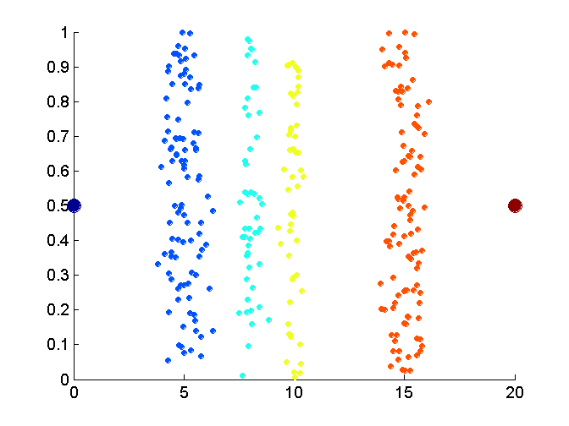
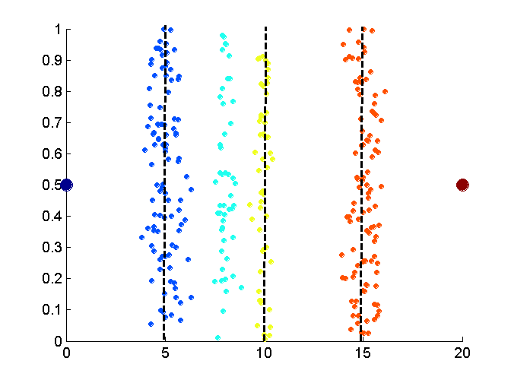
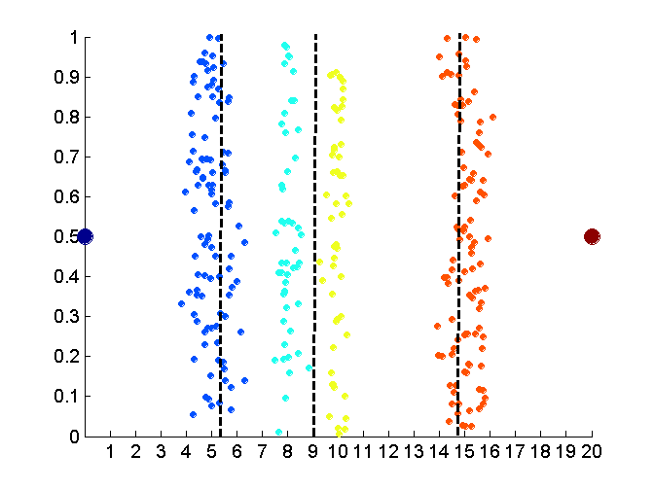
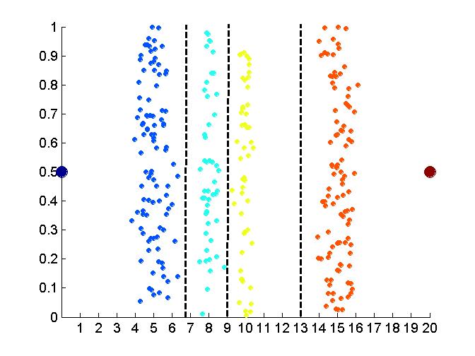
Discretization Without Using Class Labels (Binning vs. Clustering)
Data
Equal interval width (binning)
Equal frequency (binning)
K-means clustering leads to better results
76
Notes:
76

Slide 77
Discretization by Classification & Correlation Analysis
Classification (e.g., decision tree analysis)
Supervised: Given class labels, e.g., cancerous vs. benign
Using entropy to determine split point (discretization point)
Top-down, recursive split
Details to be covered in Chapter 7
Correlation analysis (e.g., Chi-merge: χ²-based discretization)
Supervised: use class information
Bottom-up merge: find the best neighboring intervals (those having similar distributions of classes, i.e., low χ² values) to merge
Merge performed recursively, until a predefined stopping condition
77
Notes:
77

Slide 78
Concept Hierarchy Generation
Concept hierarchy organizes concepts (i.e., attribute values) hierarchically and is usually associated with each dimension in a data warehouse
Concept hierarchies facilitate drilling and rolling in data warehouses to view data in multiple granularity
Concept hierarchy formation: Recursively reduce the data by collecting and replacing low level concepts (such as numeric values for age) by higher level concepts (such as youth, adult, or senior)
Concept hierarchies can be explicitly specified by domain experts and/or data warehouse designers
Concept hierarchy can be automatically formed for both numeric and nominal data. For numeric data, use discretization methods shown.

Slide 79
Concept Hierarchy Generation for Nominal Data
Specification of a partial/total ordering of attributes explicitly at the schema level by users or experts
street < city < state < country
Specification of a hierarchy for a set of values by explicit data grouping
{Urbana, Champaign, Chicago} < Illinois
Specification of only a partial set of attributes
E.g., only street < city, not others
Automatic generation of hierarchies (or attribute levels) by the analysis of the number of distinct values
E.g., for a set of attributes: {street, city, state, country}

Slide 80
Mean, Median, Mode, Range & Standard Deviation
Section - 2

Slide 81
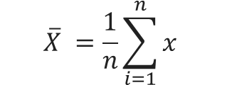
Mean (Average)
Mean is the average of a dataset
Mean is the average of a dataset.
The mean is the total of all the values, divided by the number of values.
Formula to find mean
Example
Find out mean for 12, 15, 11, 11, 7, 13 (Here total data is = 6)
$$\overline{X} =\frac{1}{n}\sum_{i=1}^{n}{x}$$
First, find the sum of the data.
12 + 15 +11 + 11 + 7 + 13 = 69
Then divide by the total number of data.
69 / 6 = 11.5
(Mean)

Slide 82
Median {Centre Or Middle Value}
The median is the middle number in a list of numbers ordered from lowest to highest.
Example
Find out Median for 12, 15, 11, 11, 7, 13, 15 (Here total data is = 7 {odd})
If count is Odd then middle number is Median
First, arrange the data in ascending order.
7, 11, 11, 12, 13, 15, 15
Partitioning data into equal half's
7, 11, 11, 12, 13, 15, 15
12 Median

Slide 83

Median {Centre Or Middle Value} (Cont..)
If count is Even then take average (mean) of middle two numbers that is Median
Example
Find out Median for 12, 15, 11, 11, 7, 13 (Here total data is = 6 {even})
First, arrange the data in ascending order.
7, 11, 11, 12, 13, 15
Calculate an average (mean) of the two numbers in the middle.
7, 11, 11, 12, 13, 15
(11 + 12)/2 = 11.5 Median

Slide 84
Mode
The mode is the number that occurs most often within a set of numbers.
Example
If more than three numbers repeats within a set of numbers then it is called as multimodal.
12, 15, 11, 11, 7, 13
12, 12 15, 11, 11, 7, 13, 7
11 Mode (Unimodal)
7, 11, 12 Mode (Trimodal)
12, 15, 11, 11, 7, 12, 13
12, 15, 11, 10, 7, 14, 13
11, 12 Mode (Bimodal)
No Mode

Slide 85
Range
The range of a set of data is the difference between the largest and the smallest number in the set.
Example
Find the range for given data 40, 30, 43, 48, 26, 50, 55, 40, 34, 42, 47, 50
In our example largest number is 55, and subtract the smallest number is 26.
First, arrange the data in ascending order.
26, 30, 34, 40, 40, 42, 43, 47, 48, 50, 50, 55
55 – 26 = 29 Range

Slide 86
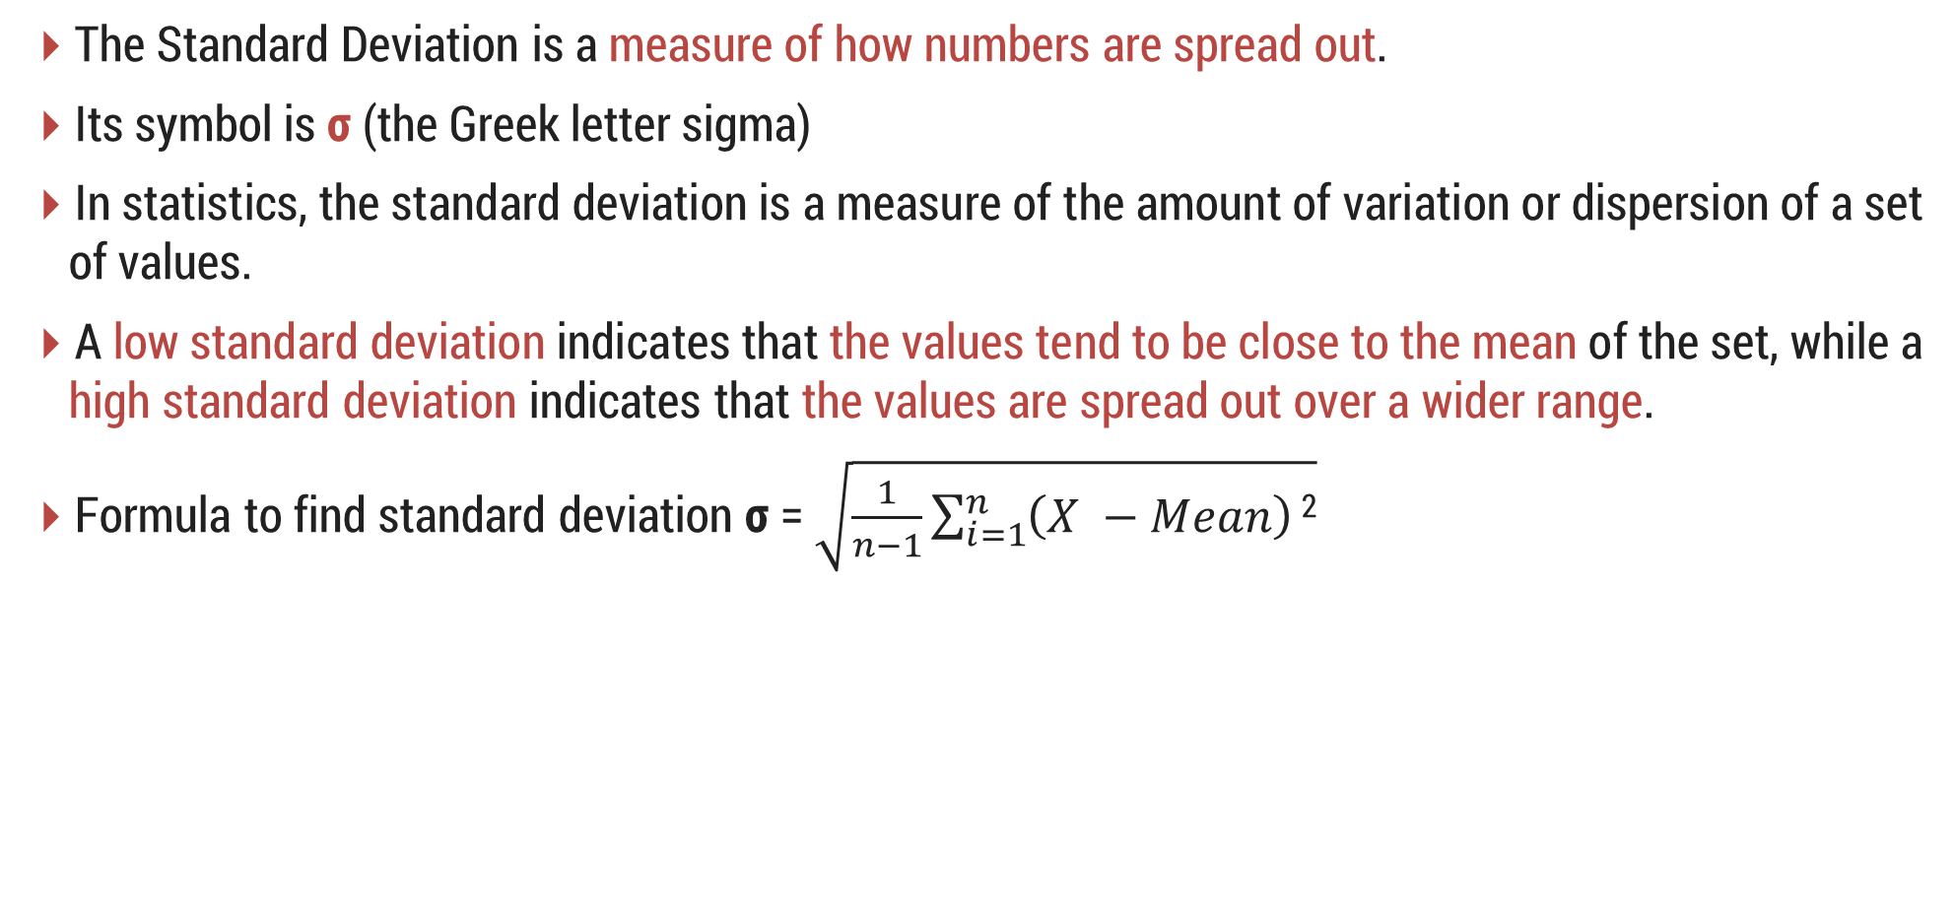
Standard Deviation (σ)
The Standard Deviation is a measure of how numbers are spread out.
Its symbol is σ (the Greek letter sigma)
In statistics, the standard deviation is a measure of the amount of variation or dispersion of a set of values.
A low standard deviation indicates that the values tend to be close to the mean of the set, while a high standard deviation indicates that the values are spread out over a wider range.
Formula to find standard deviation σ = $\sqrt{\frac{1}{n−1}\sum_{i=1}^{n}{\left(X −Mean\right)}\text{2}}$

Slide 87
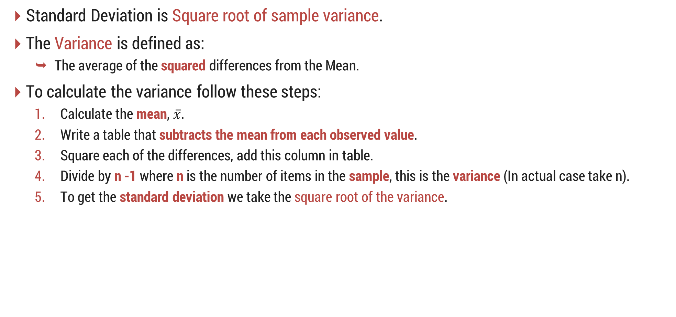
Standard Deviation (σ) Cont..
Standard Deviation is Square root of sample variance.
The Variance is defined as:
The average of the squared differences from the Mean.
To calculate the variance follow these steps:
Calculate the mean, $\overline{x}$.
Write a table that subtracts the mean from each observed value.
Square each of the differences, add this column in table.
Divide by n -1 where n is the number of items in the sample, this is the variance (In actual case take n).
To get the standard deviation we take the square root of the variance.

Slide 88
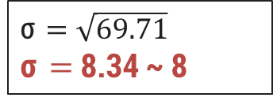
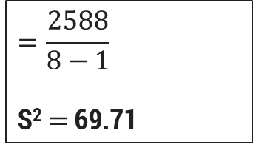
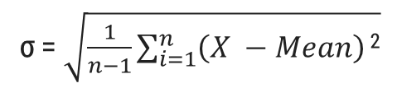
Standard Deviation (σ) Cont..
The owner of the Indian restaurant is interested in how much people spend at the restaurant.
He examines 8 randomly selected receipts for parties and writes down the following data.
44, 50, 38, 96, 42, 47, 40, 39
Find out Mean (Mean is 49.5 for given data)
Write a table that subtracts the mean from each observed value. (2nd step)
σ = $\sqrt{\frac{1}{n−1}\sum_{i=1}^{n}{\left(X −Mean\right)}\text{2}}$
Step : 3
X | X - Mean | Value | (X – Mean)²
44 | 44 - 49.5 | -5.5 | 30.25
50 | 50 - 49.5 | 0.5 | 0.25
38 | 38 - 49.5 | 11.5 | 132.25
96 | 96 - 49.5 | 46.5 | 2162.25
42 | 42 - 49.5 | -7.5 | 56.25
47 | 47 - 49.5 | -2.5 | 6.25
40 | 40 - 49.5 | -9.5 | 90.25
39 | 39 - 49.5 | -10.5 | 110.25
Total |  |  | 2588
Step : 4
$$=\frac{2588}{8−1}$$
S² $=$69.71
Step : 5
σ $=\sqrt{69.71}$
σ $=$ 8.34 ~ 8

Slide 89
Standard Deviation (σ) Cont..
Standard deviation can be thought of measuring how far the data values lie from the mean, we take the mean and move on standard deviation in either direction.
The mean for this example is µ = 49.5 and the standard deviation is σ = 8.
Now, we add & subtract values with mean like 49.5 - 8 = 41.5 and 49.5 + 8 = 57.5
This means that most of the data probably spend between 41.5 and 57.5.
38, 39, 40, 42, 44, 47, 50, 96
If all data are same then variance & standard deviation is 0 (zero).

Slide 90
Summary
Mean: Mean is the average of a dataset
Median: Median is the middle number in a dataset when the data is arranged in numerical order (Sorted Order).
Mode: The mode is the number that occurs most often within a set of numbers.
Range: The range of a set of data is the difference between the largest and the smallest number in the set.
Standard Deviation: The Standard Deviation is a measure of how numbers are spread out in dataset.
Definition
Mode
Range
Median
Mean
Standard Deviation

Slide 91
Attribute Types
Section - 3

Slide 92
What is an Attribute?
The attribute can be defined as a field for storing the data that represents the characteristics of a data object.
It can also be viewed as a property, characteristics, feature or column of a data object.
It represents the different features of an object (real world entity) like..
👨 Person → Name, Age, Qualification, Birthdate etc.
💻 Computer → Brand, Model, Processor, RAM etc.
📚 Book → Book Name, Author, Price, ISBN etc.
An attribute set defines an object.
The object is also referred to as a record of the instances or entity.

Slide 93
Attribute Types
Attribute types can be divided into mainly two categories.
Quantitative
Discrete
Continuous
Qualitative
Nominal
Ordinal
Binary
Symmetric
Asymmetric
Quantitative
Discreate
Continuous
Qualitative
Nominal
Ordinal
Binary
Symmetric
Asymmetric

Slide 94
1. Quantitative Attribute
Attribute Types
Quantitative is an adjective that simply means something that can be measured.
It is a special attribute that is used to compare two values, i.e., it is used to compare a user-defined value against an upper limit and a lower limit.
Example
We can count the number of sheep on a farm or measure the liters of milk produced by a cow.
Consider a query to find all patients with low or high blood glucose levels. In database, for each patient a lower value and an upper value for blood glucose level is stored in the Result class.
To find patients with low/high level of blood glucose, without QA you would have to specify a limit on the Low attribute or the High attribute of the Result class.
While defining limit you can use Between, Equals, Less than, Less than or Equal to, Greater than, Greater than or Equal as relational operators.

Slide 95
1. Quantitative Attribute
Attribute Types
1) Discrete Attribute
A discrete attribute has a finite or countably infinite set of values, which may or may not be represented as integers.
The attributes hair_color, smoker, medical_test, and drink_size each have a finite number of values, and so are discrete.
CustomerID in a table has countably infinite set of values because over a time period it grows.
2) Continues Attribute
Real numbers as attribute values.
The attributes temperature, height, or weight are the examples of continuous attributes.
Practically, real values can only be measured and represented using a finite number of digits.
Continuous attributes are typically represented as floating- point variables.

Slide 96
2. Qualitative Attribute
Attribute Types
Qualitative data deals with characteristics and descriptors that can't be easily measured, but can be observed subjectively—such as smells, tastes, textures, attractiveness, and color.
Simple arithmetic attributes that is named or described in words.
It is represented in integer or real values.
Results of qualitative attribute are often quoted on scales.
Below are the qualitative Attributes.
Nominal
Ordinal
Binary
Symmetric
Asymmetric

Slide 97
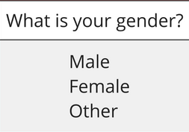
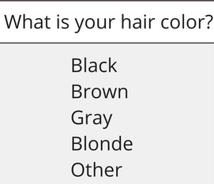
2. Qualitative Attribute Cont..
Attribute Types
1) Nominal Attribute
Nominal attributes are named attributes which can be separated into discrete (individual) categories which do not overlap.
Nominal attributes values also called as distinct values.
Example

Slide 98
2. Qualitative Attribute Cont..
Attribute Types
2) Ordinal Attribute
Ordinal attribute is the order of the values, that’s important and significant, but the differences between each one is not really known.
Example
Rankings → 1st, 2nd, 3rd
Ratings →
We know that a 5 star is better than a 2 star or 3 star, but we don’t know and cannot quantify–how much better it is?
3) Binary Attribute
Binary attributes are the categorical attributes with only two possible values (yes or no), (true or false), (0 or 1).
Symmetric binary attribute is the attribute which each value is equally valuable (male or female). The male here is not more important than the female value.
Asymmetric is the attribute which the two states is not equally important, for example, the medical test (positive or negative), here, the positive results is more significant than the negative one.
,

Slide 99
Extra
Attribute Types
Interval Attribute
Interval attribute comes in the form of a numerical value where the difference between points is meaningful.
Example
Temperature → 10°-20°, 30°-50°, 35°-45°
Calendar Dates → 15th – 22nd, 10th – 30th
We can not find true zero (absolute) value with interval attributes.
Ratio Attribute
Ratio attribute is looks like interval attribute, but it must have a true zero (absolute) value.
It tells us about the order and the exact value between units or data.
Example
Age Group → 10-20, 30-50, 35-45 (In years)
Mass → 20-30 kg, 10-15 kg
It does have a true zero (absolute) so, it is possible to compute ratios.

Slide 100
Data Summarization
Section - 4

Slide 101
Why Data Summarization?
As we are living in a digital world where data transfers in a second and it is much faster than a human capability.
In the corporate field, employees work on a huge volume of data which is derived from different sources like Social Network, Media, Newspaper, Book, cloud media storage etc.
But sometimes it may create difficulties for you, to summarize the data.
Sometimes you do not expect data volume because when you retrieve data from relational sources you can not predict that how much data will be stored in the database.
As a result, data becomes more complex and takes time to summarize information.

Slide 102
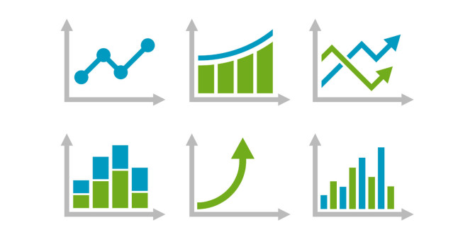
What is Data Summarization?
Summarization is a key data mining concept which involves techniques for finding a compact description of a dataset.
It is aimed at extracting useful information and general trends from the raw data.
Two methods for data summarization are through tables and graphs.
Tables are row & column representation of the dataset, you can apply aggregate functions on it.
Graphs showing the relation between variable quantities, typically of two variables, each measured along one of a pair of axes at right angles.

Slide 103
Data Cleaning
Section - 4

Slide 104

Data Cleaning
Fill in missing values
Ignore the tuple
Fill missing value manually
Fill in the missing value automatically
Use a global constant to fill in the missing value
Identify outliers and smooth out noisy data
Binning Method
Regression
Clustering
Correct inconsistent data
Resolve redundancy caused by data integration

Slide 105
1) Fill in missing values
Data Cleaning
Ignore the tuple (record/row):
Usually done when class label is missing.
Example
The task is to distinguish between two types of emails, “spam” and “non-spam” (Ham).
Spam & non-spam are called as class label.
If an email comes to you, in which class label is missing then it is discarded.
Fill missing value manually:
Use the attribute mean (average) to fill in the missing value and also use the attribute mean (average) for all samples belonging to the same class.
Fill in the missing value automatically:
Predict the missing value by using a learning algorithm:
Consider the attribute with the missing value as a dependent variable and run a learning algorithm (usually Naive Bayes or Decision tree) to predict the missing value.
Use a global constant to fill in the missing value
Replace all missing attribute values by the same constant such as a label like
“Unknown”.

Slide 106
2) Identify outliers and smooth out noisy data
Data Cleaning
There are three data smoothing techniques as follows..
Binning :
Binning methods smooth a sorted data value by consulting its “neighborhood” that is, the values around it.
Regression :
It conforms data values to a function.
Linear regression involves finding the “best” line to fit two attributes (or variables) so that one attribute can be used to predict the other.
Outlier analysis :
Outliers may be detected by clustering for example, where similar values are organized into groups or “clusters”.
In this, values that fall outside of the set of clusters may be considered as outliers.

Slide 107

1. Binning Method
Data Cleaning
Binning method is a top-down splitting technique based on a specified number of bins.
In this method the data is first sorted and then the sorted values are distributed into a number of buckets or bins.
For example, attribute values can be discretized (separated) by applying equal-width or equal-frequency binning, and then replacing each value by the bin mean, median or boundaries.
It can be applied recursively to the resulting partitions to generate concept hierarchies.
It does not use class information, therefore it is called as unsupervised discretization technique.
It used to minimize the effects of small observation errors.
Identify outliers and smooth out noisy data

Slide 108
1. Binning Method Cont..
Data Cleaning
There are basically two types of binning approaches..
Equal width (or distance) binning :
The simplest binning approach is to partition the range of the variable into k equal-width intervals.
The interval width is simply the range [Min, Max] of the variable divided by N,
Width = Max – Min / N (Number of Bins)
Example
Data: 5,10,11,13,15, 35, 50, 55, 72, 92, 204, 215
As per above formula we have Max=215, Min=5, Number of Bins=3
70+5=75 (from 5 to 75) = Bin 1: 5,10,11,13,15, 35, 50, 55, 72
70+75=145 (from 75 to 145) = Bin 2: 92
70+145=215 (from 145 to 215) = Bin 3: 204, 215
Equal depth (or frequency) binning :
In equal-frequency binning we divide the range [Max, Min] of the variable into intervals that contain (approximately) equal number of points; equal frequency may not be possible due to repeated values.
Identify outliers and smooth out noisy data

Slide 109
1. Binning Method Cont..
Data Cleaning
Bin Operations
Smoothing by bin means
In smoothing by bin means, each value in a bin is replaced by the mean value of the bin.
Smoothing by bin median
In this method each bin value is replaced by its bin median value.
Smoothing by bin boundary
In smoothing by bin boundaries, the minimum and maximum values in a given bin are identified as the bin boundaries.
Each bin value is then replaced by the closest boundary value.
Identify outliers and smooth out noisy data

Slide 110
Binning Method Example – {Bin Means}
Data Cleaning
Given data: 4, 8, 9, 15, 21, 21, 24, 25, 26, 28, 29, 34
Step: 1
Partition into equal-depth [n=4]:
Bin 1: 4, 8, 9, 15
Bin 2: 21, 21, 24, 25
Bin 3: 26, 28, 29, 34
Step: 2
Smoothing by bin means:
Bin 1: 9, 9, 9, 9
Bin 2: 23, 23, 23, 23
Bin 3: 29, 29, 29, 29
Bin Means
(4 + 8 + 9 + 15)/4 = 9
(21 + 21 + 24 + 25)/4 = 23
(26 + 28 + 29 + 34)/4 = 29
Identify outliers and smooth out noisy data

Slide 111
Binning Method Example – {Bin Boundaries}
Data Cleaning
Given data: 4, 8, 9, 15, 21, 21, 24, 25, 26, 28, 29, 34
Step: 1
Partition into equal-depth [n=4]:
Bin 1: 4, 8, 9, 15
Bin 2: 21, 21, 24, 25
Bin 3: 26, 28, 29, 34
Step: 2
Smoothing by bin boundaries:
Bin 1: 4, 4, 4, 15
Bin 2: 21, 21, 25, 25
Bin 3: 26, 26, 26, 34
Identify outliers and smooth out noisy data

Slide 112
2. Regression
Data Cleaning
Data smoothing can also be done by regression, a technique that conforms data values to a function.
Regression analysis is a way to find trends in data & it is also called as mathematically describes the relationship between independent variables and the dependent variable.
It can be divided into two categories..
Linear regression :
It involves finding the “best” line to fit two attributes (or variables) so that one attribute can be used to predict the other.
In this, analysis on a single x variable for each dependent “y” variable. For example: (x₁, Y₁).
Multiple linear regression :
An extension of linear regression, where more than two attributes are involved and the data are fit to a multidimensional surface.
It uses multiple “x” variables for each independent variable: (x1)₁, (x2)₁, (x3)₁, Y₁).
Identify outliers and smooth out noisy data

Slide 113
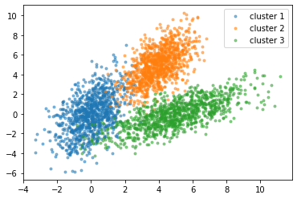
3. Clustering
Data Cleaning
Cluster analysis or clustering is the task of grouping a set of objects in such a way that objects in the same group (called a cluster) are more similar (in some sense) to each other than to those in other groups (clusters).
Cluster analysis as such is not an automatic task, but an iterative process of knowledge discovery or interactive multi-objective optimization that involves trial and failure.
It is often necessary to modify data preprocessing and model parameters until the result achieves the desired properties.
Identify outliers and smooth out noisy data

Slide 114
Correct Inconsistent Data
Data Cleaning
With larger datasets, it can be difficult to find all of the inconsistencies.
It contains similarity in codes or names.
We can manually solve common mistakes like spelling, grammar, articles or use other tools for it.

Slide 115
Resolve redundancy caused by data integration
Data Cleaning
Data redundancy occurs in database systems which have a field that is repeated in two or more tables.
When customer data is duplicated and attached with each product bought, then redundancy of data is known as inconsistency.
So, the entity "customer" might appear with different values.
Database normalization prevents redundancy and makes the best possible usage of storage.
The proper use of foreign keys can minimize data redundancy and reduce the chance of destructive anomalies appearing.

Slide 116
Data Integration
Section - 5

Slide 117
Data Integration
Combines data from multiple sources into a coherent store
Schema integration: e.g., A.cust-id ≡ B.cust-#
Integrate metadata from different sources
Entity identification problem
Identify real world entities from multiple data sources, e.g., Bill Clinton = William Clinton
Detecting and resolving data value conflicts
For the same real world entity, attribute values from different sources are different
Possible reasons: different representations, different scales, e.g., metric vs. British units

Slide 118
Handling Redundancy in Data Integration
Redundant data occur often when integration of multiple databases
Object identification: The same attribute or object may have different names in different databases
Derivable data: One attribute may be a “derived” attribute in another table, e.g., annual revenue
Redundant attributes may be able to be detected by correlation analysis and covariance analysis.
Careful integration of the data from multiple sources may help reduce/avoid redundancies and inconsistencies and improve mining speed and quality.

Slide 119
Data Transformation
Section - 6

Slide 120
Data Transformation
A function that maps the entire set of values of a given attribute to a new set of replacement values that each old value can be identified with one of the new values
Methods
Smoothing: Remove noise from data
Attribute/feature construction
New attributes constructed from the given ones
Aggregation: Summarization, data cube construction
Normalization: Scaled to fall within a smaller, specified range
Min-max normalization
Z-score normalization
Normalization by decimal scaling
Discretization: Concept hierarchy climbing

Slide 121
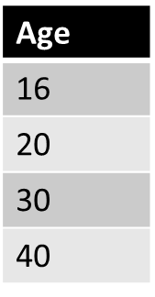
1. Min-Max Normalization
Data Transformation
Min max is a technique that helps to normalizing the data.
It will scale the data between 0 and 1 or within specified range.
Example
Formula : V’ $=\frac{v −MinA}{MaxA −MinA}{\left(NewMaxA −NewMinA\right)}^{}+NewMinA$
Given data
Min : Minimum value = 16
Max : Maximum value = 40
V = Respective value of attributes. In our example V₁= 16, V₂=20, V₃=30 & V₄=40.
NewMax = 1
NewMin = 0

Slide 122
1. Min-Max Normalization Cont..
Data Transformation
Example
Formula : V’ $=\frac{v −MinA}{MaxA −MinA}{\left(NewMaxA −NewMinA\right)}^{}+NewMinA$
For Age 16 :
MinMax (v’) = (16 – 16)/(40-16) * (1 – 0) + 0
= 0 / 24 * 1
= 0
For Age 30 :
MinMax (v’) = (30 – 16)/(40-16) * (1 – 0) + 0
= 14 / 24 * 1
= 0.58
For Age 20 :
MinMax (v’) = (20 – 16)/(40-16) * (1 – 0) + 0
= 4 / 24 * 1
= 0.16
For Age 40 :
MinMax (v’) = (40 – 16)/(40-16) * (1 – 0) + 0
= 24 / 24 * 1
= 1
Age | After Min-max normalization
16 | 0
20 | 0.16
30 | 0.58
40 | 1

Slide 123
2. Decimal Scaling
Data Transformation
In this technique we move the decimal point of values of the attribute.
This movement of decimal points totally depends on the maximum value among all values in the attribute.
Value V of attribute A can be normalized by the following formula
Normalized value of attribute
V’= V / 10^{j}
Example
CGPA | Formula | After Decimal Scaling
2 | 2 / 10 | 0.2
3 | 3 / 10 | 0.3
We will check maximum value among our attribute CGPA.
Maximum value is 3 so, we can convert it into decimal by dividing with 10. why 10?
We will count total digits in our maximum value and then put 1.
After 1 we can put zeros equal to the length of maximum value.
Here 3 is maximum value and total digits in this value is only 1 so, we will put one zero after 1.
Where j is the smallest integer such that Max(|ν’|) < 1

Slide 124


3. Z-Score Normalization
Data Transformation
It is also called zero-mean normalization.
The essence of this technique is the data transformation by the values conversation to a common scale where an average number equals zero and a standard deviation is one.
To find z-score values..
$$v′=\frac{v−μ_{A}}{σ_{A}}$$
Where μ: Mean, σ: Standard deviation
Example
Let μ = 54,000, σ = 16,000
Find z-score for 73,600,
$$\frac{73,600−54,000}{16,000}=1.225$$
Z-score for 73600: 1.225

Slide 125
Data Reduction
Section - 7

Slide 126
Data Reduction
Why Data Reduction?
A database/data warehouse may store terabytes of data.
Complex data analysis may take a very long time to run on the complete data set.
What is Data Reduction?
Data reduction process reduces the size of data and makes it suitable and feasible for analysis.
In the reduction process, integrity of the data must be preserved and data volume is reduced.
There are many techniques that can be used for data reduction like
Dimensionality reduction
Numerosity reduction
Data compression

Slide 127
1. Dimensionality Reduction
Data Reduction
Dimensionality reduction, or dimension reduction, is the transformation of data from a high-dimensional space into a low-dimensional space so that the low-dimensional representation retains some meaningful properties of the original data, ideally close to its intrinsic dimension.
The number of input variables or features for a dataset is referred to as its dimensionality.
Dimensionality reduction refers to techniques that reduce the number of input variables in a dataset.
Example
Dimensional reduction can be discussed through a simple e-mail classification problem, where we need to classify whether the e-mail is spam or not.
This can involve a large number of features, such as whether or not the e-mail has a generic title, the content of the e-mail, whether the e-mail uses a template, etc.

Slide 128
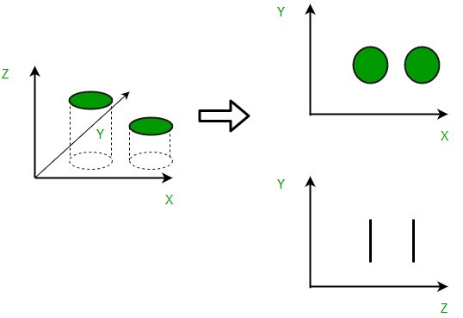
1. Dimensionality Reduction Cont..
Data Reduction
A 3-D classification problem can be hard to visualize, whereas a 2-D one can be mapped to a simple 2 dimensional space, and a 1-D problem to a simple line.

Slide 129
2. Numerosity Reduction
Data Reduction
Numerosity Reduction is a data reduction technique which replaces the original data by smaller form of data representation.
There are two techniques for numerosity reduction- Parametric and Non-Parametric methods.
Parametric Methods
For parametric methods, data is represented using some model.
The model is used to estimate the data, so that only parameters of data are required to be stored, instead of actual data.
Regression and Log-Linear methods are used for creating such models.
Non-Parametric Methods
These methods are used for storing reduced representations of the data include histograms, clustering, sampling and data cube aggregation.

Slide 130
Regression
Data Reduction
Regression can be a simple linear regression or multiple linear regression.
When there is only single independent attribute, such regression model is called simple linear regression and if there are multiple independent attributes, then such regression models are called multiple linear regression.
In linear regression, the data are modeled to a fit straight line.
For example, a random variable y can be modeled as a linear function of another random variable x with the equation y = ax+b
Where a and b (regression coefficients) specifies the slope and y-intercept of the line, respectively.
In multiple linear regression, y will be modeled as a linear function of two or more predictor (independent) variables.

Slide 131
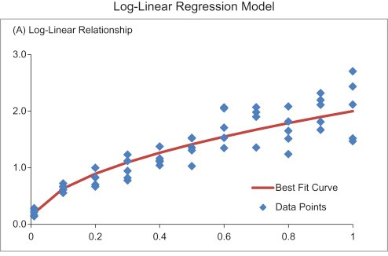
Log-Linear Model
Data Reduction
Log-linear model can be used to estimate the probability of each data point in a multidimensional space for a set of discretized attributes, based on a smaller subset of dimensional combinations.
This allows a higher-dimensional data space to be constructed from lower-dimensional attributes.
Regression and log-linear model can both be used on sparse data (most of the elements are zero), although their application may be limited.

Slide 132
Non-Parametric Methods
Data Reduction
Histograms
Histogram is the data representation in terms of frequency.
It uses binning to approximate data distribution and is a popular form of data reduction.
Clustering
Clustering divides the data into groups/clusters, it partitions the whole data into different clusters.
In data reduction, the cluster representation of the data are used to replace the actual data, It also helps to detect outliers in data.
Sampling
Sampling can be used for data reduction because it allows a large data set to be represented by a much smaller random data sample (or subset).
Data Cube Aggregation
Data cube aggregation involves moving the data from detailed level to a fewer number of dimensions.
The resulting data set is smaller in volume, without loss of information
necessary for the analysis task.

Slide 133
3. Data Compression
Data Reduction
Data Compression is a reduction in the number of bits needed to represent data.
Compressing data can save storage capacity, speed up file transfer, and decrease costs for storage hardware and network bandwidth.
Compressing data can be a lossless or lossy process.
Lossless compression
It enables the restoration of a file to its original state, without the loss of a single bit of data, when the file is uncompressed.
Lossless compression is the typical approach with executables, as well as text and spreadsheet files, where the loss of words or numbers would change the information.
Lossy compression
It permanently eliminates bits of data that are redundant, unimportant or imperceptible.
Lossy compression is useful with graphics, audio, video and images, where the removal of some data bits has little or no discernible effect on the representation of the content.

